Slide 1
Artificial Intelligence: An Overview (2)
Jiun-Wei Liou
Ming-Chi University of Technology

Slide 2
Outline
Categories of AI introduction
Data science
Machine Learning
Deep Learning
Future thoughts of AI
Warnings
Promises
Online AI materials

Slide 3
Data Science
Overview
Process stages
Methods

Slide 4
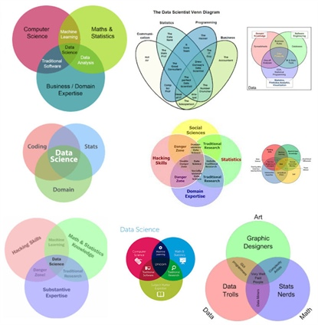
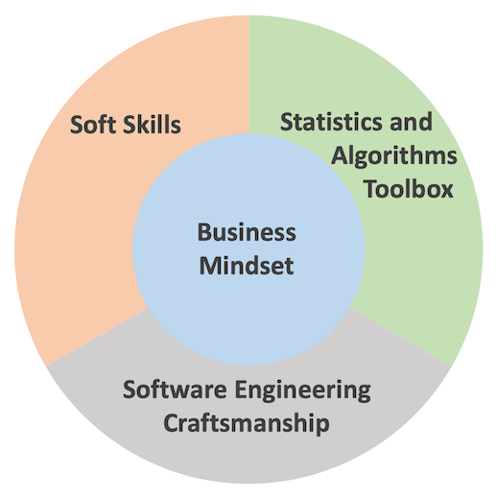
Data Science Overview
Venn diagram and wave of data science

Slide 5
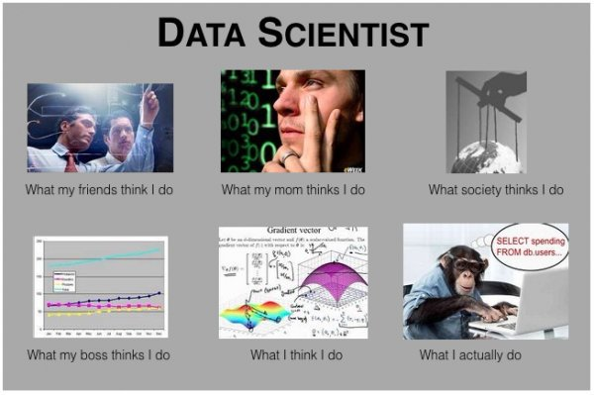
What Data Scientist Do
Conventional opinions

Slide 6
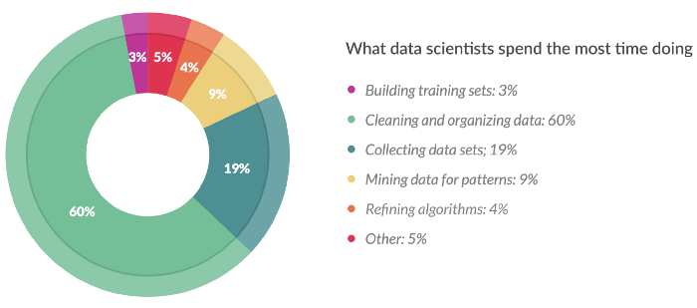
What Data Scientist Do
By survey
Data related: 82%, Program related: 13%, Other: 5%.

Slide 7
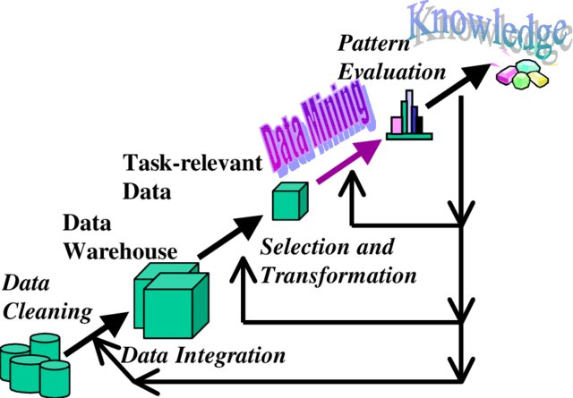
Data science via data mining
Process of Data mining
Data cleaning
Data selection
Data transformation
Data mining == ML/AI tools kicks in.
Pattern Evaluation
Result Interpretation

Slide 8
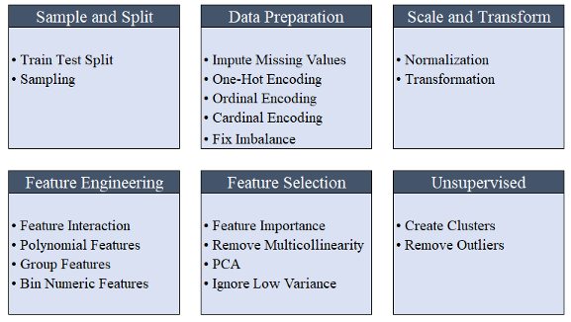
Data preprocessing (Step 1-3)
Example: PyCaret Preprocessing

Slide 9
Data science Methods (Step 4-5)
Categorization of Analysis Methods

Slide 10
Data science Methods (Step 4-5)
Difference from Classification and Clustering
Clustering | Classification
Unsupervised data | Supervised data
Does not highly value training sets | Does highly value training sets
Works solely with unlabeled data | Involves both unlabeled and labeled data
Aims to identify similarities among data | Aims to verify where a datum belongs to
Specifies required change | Does not specify required improvement
Has a single phase | Has two phases
Determining boundary conditions is not paramount | Identifying the boundary conditions is essential in executing the phases
Does not generally deal with prediction | Deals with prediction
Mainly employs two algorithms | Has a number of probable algorithms to use
Process is less complex | Process is more complex

Slide 11
Data science Methods (Step 4-5)
Detail methods for each category:
Association Rules: A priori algorithm, Sequential Pattern Mining, etc.
Classification: Decision Tree, k-Nearest Neighbors, SVM, ANN, etc.
Clustering: k-Means, Hierarchical Clustering, Expectation Maximization, etc.
Regression: Linear Regression, Logistic Regression, etc.

Slide 12
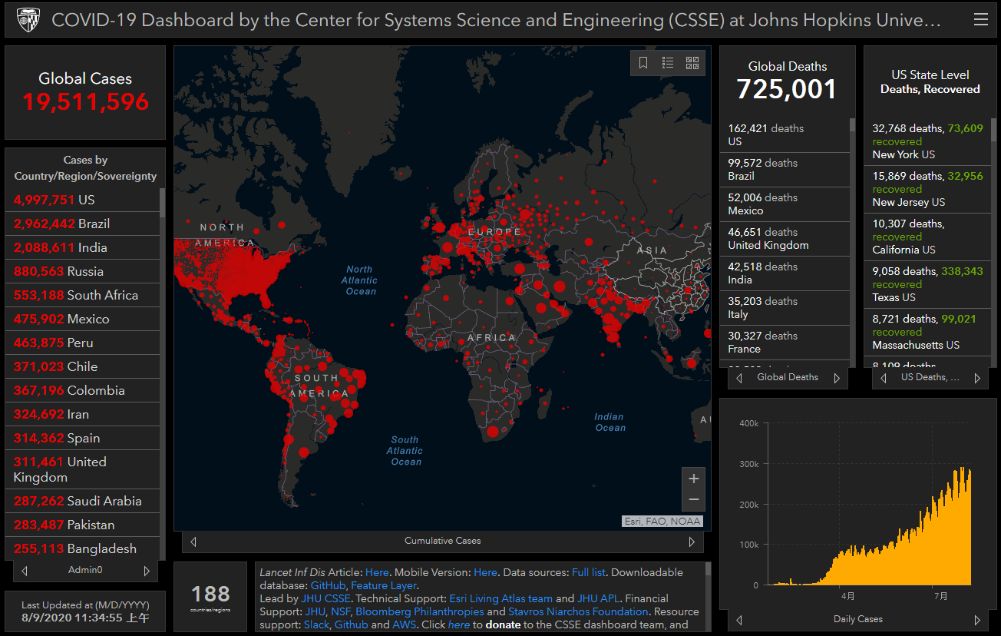
Data Visualization (Step 6)
Visualization as result interpretation

Slide 13
Machine Learning Outline
Overview
Introduction by categorization
Principles of Machine Learning

Slide 14
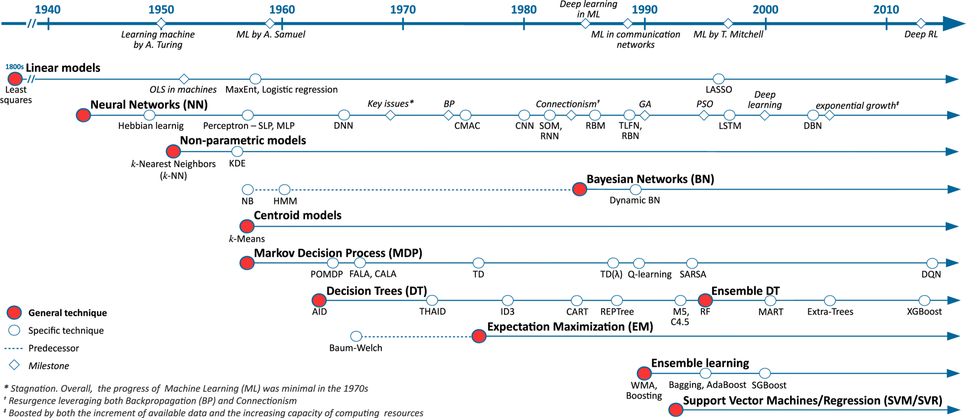
Machine Learning
Overview from history

Slide 15
Machine Learning
Categorization according to styles:
Supervised Learning
Unsupervised Learning
Semi-supervised Learning
Reinforcement Learning

Slide 16
Supervised Learning and Unsupervised Learning
Mentioned in Data Science Section as Classification for Supervised Learning and Clustering for Unsupervised Learning.
So available methods for these categories are similar to those specified in Data Science Section.
Detail of approaches will be available in the next lecture.

Slide 17
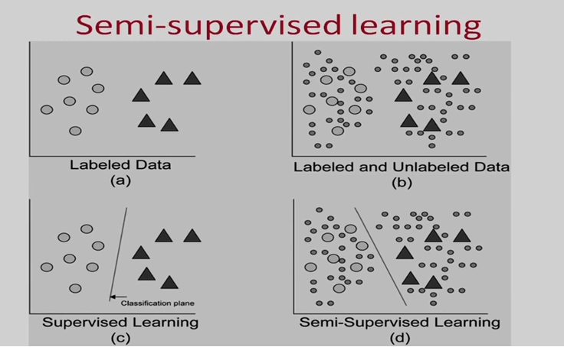
Semi-supervised Learning
Some of data with labels to train others.

Slide 18
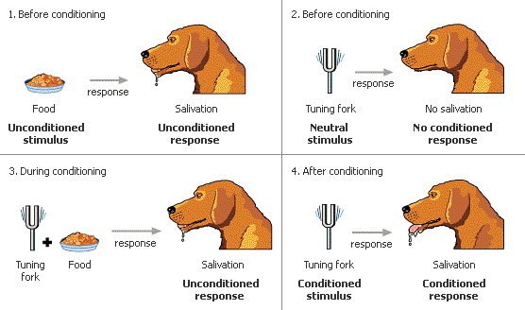
Reinforcement Learning
Behavioristic Psychology: Pavlov’s Dog.
Learning Machine becomes Agents.
Learning from Environment

Slide 19
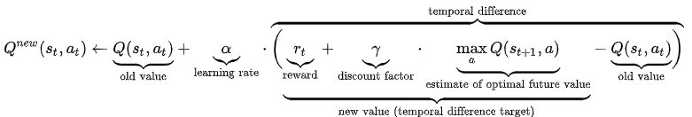
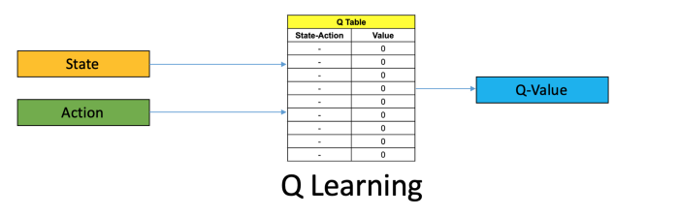
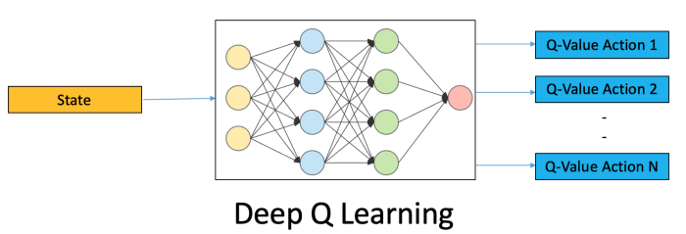
Reinforcement Learning
Q-learning introduction
Reward as function of State and Action.
From lookup table to deep networks.

Slide 20
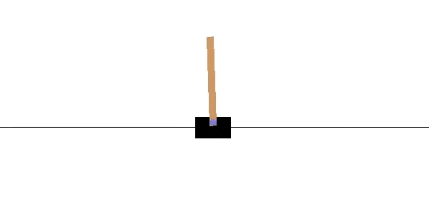
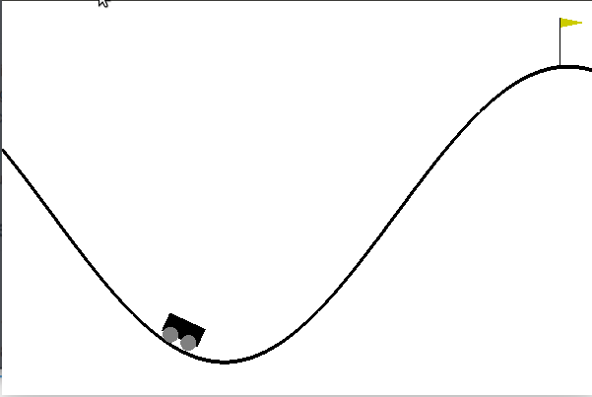
Reinforcement Learning
Examples
Cart poles
Mountain Car
Mu-Zero (for games)

Slide 21
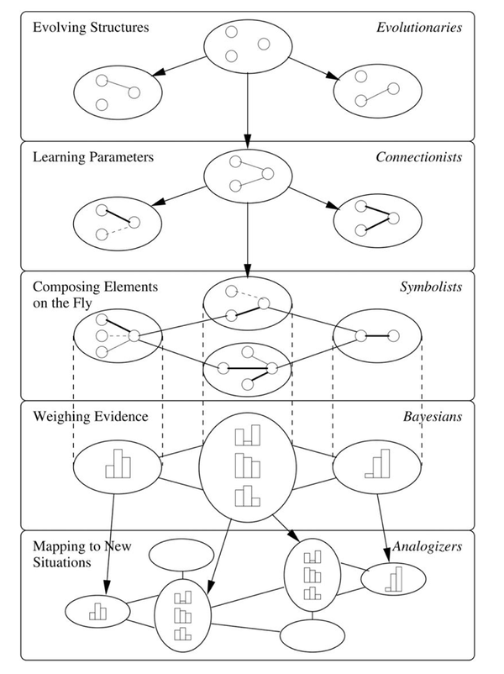
Machine Learning
Categorization according to theories:
Symbolism
Connectionism
Evolutionism
Bayesian
Analogism

Slide 22
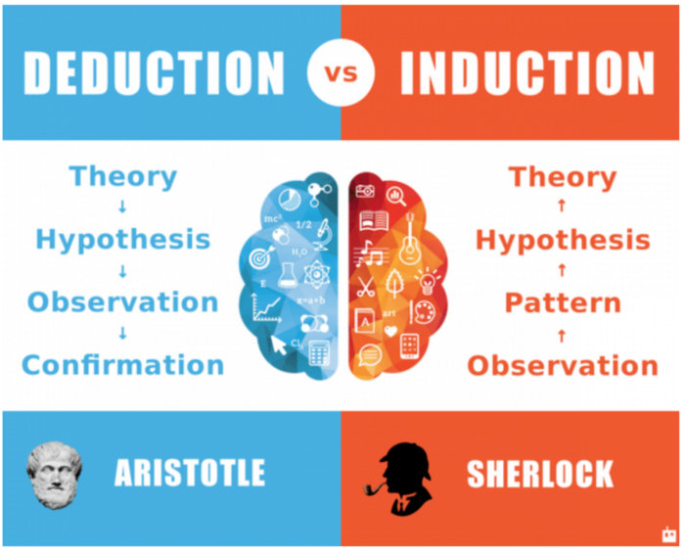
Symbolism
Focus: Inductive Reasoning.
Representation: Logic.
Evaluation target: Accuracy.
Optimization: Inverse deduction.

Slide 23
Connectionism
Focus: Reverse Engineering Brain.
Representation: Neural Networks.
Evaluation target: (Mean) Squared Errors.
Optimization: Gradient Descent.
For more details, later or ANN-related lecture will discussed.

Slide 24
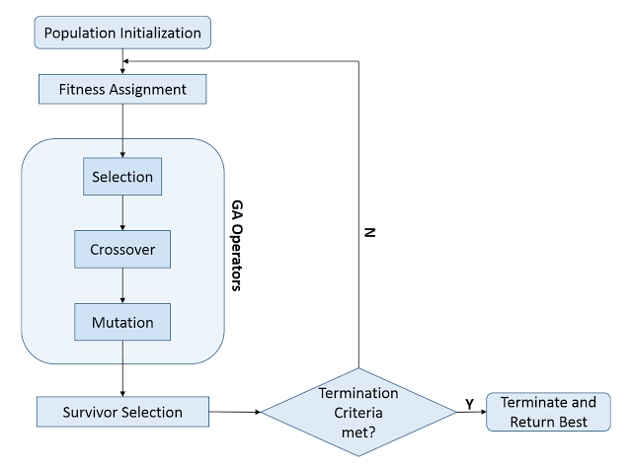
Evolutionism
Focus: Natural Selection.
Representation: Genetic Programming.
Evaluation target: Fitness.
Optimization: Genetic Search.

Slide 25
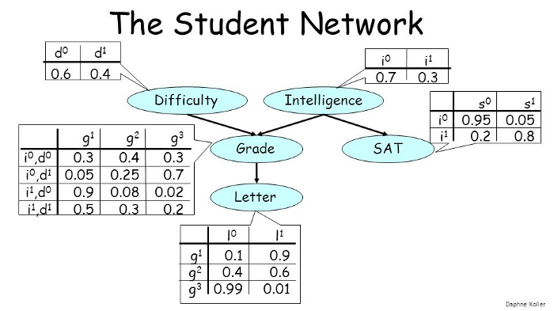
Bayesian
Focus: Uncertainty.
Representation: Graphical Models.
Evaluation target: Posterior Probability.
Optimization: Probabilistic Inference.

Slide 26
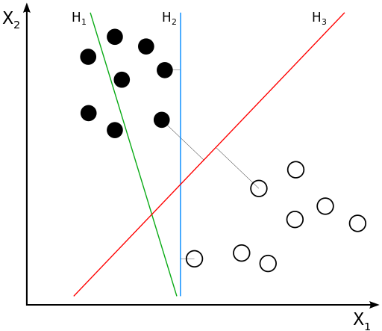
Analogism
Focus: Exemplar or Instance-based by Data(Instance) Similarity.
Representation: Support Vector Machine.
Evaluation target: Margins.
Optimization: Constrained Optimization.

Slide 27
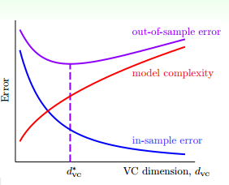
Principle of Machine Learning
Why splitting data to training, validation and testing data?
Our model can perform well on training data.
Using more complex model can fit training data better.
But complex model generate penalty for out-of-sample error.
Validation error: Internal estimating out-of-sample error of model. Testing error: For real out-of-sample error reporting.

Slide 28
Principle of Machine Learning
Occam’s Razor: The simplest model that fits the data is also the most plausible.
Sampling Bias: If the data is sampled in a biased way, learning will produce a similarly biased outcome.
Data snooping: If a data set has affected any step in he learning process, its ability to access the outcome has been compomised

Slide 29
Deep Learning
Popular deep learning models
Deep Neural Networks
Convolutional Neural Networks
Recurrent Neural Networks
Auto-encoder/decoder
Generative Adversarial Networks

Slide 30
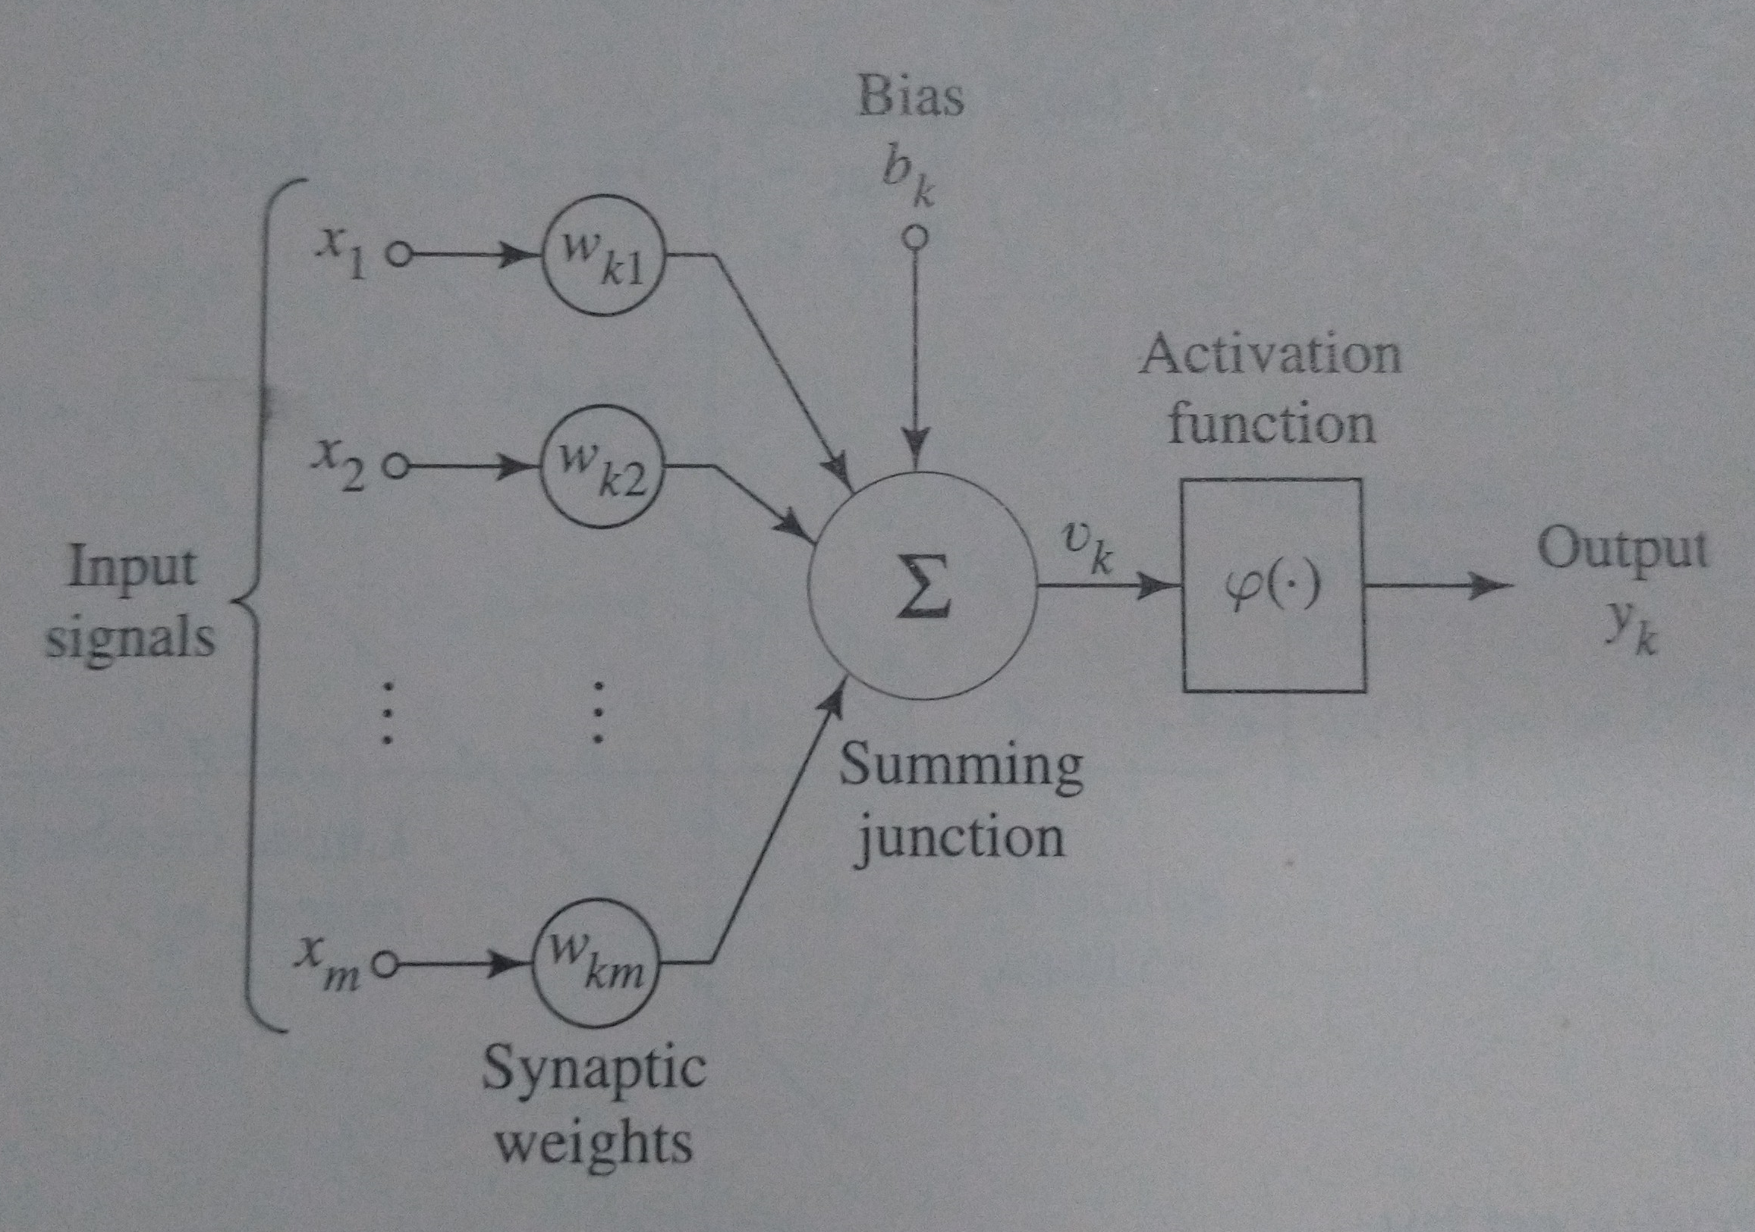
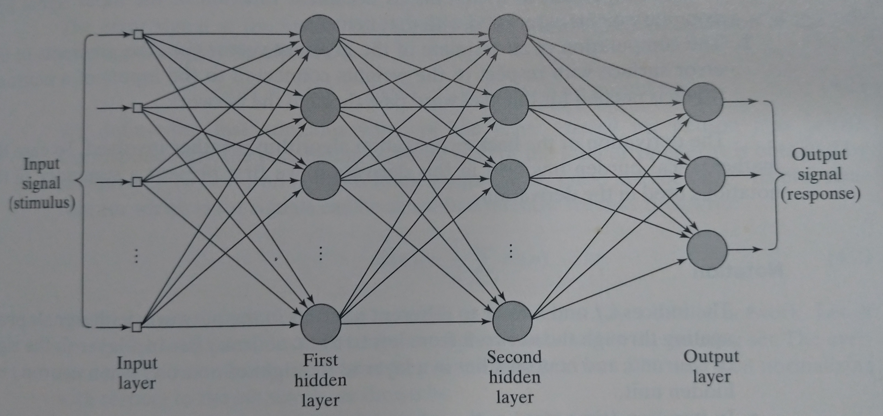
Neural Networks
Perceptron Model
Multilayer Perceptron: Structure

Slide 31
Deep Neural Networks
Applying and Learning Process:
Mainstream Activation functions selection:
Linear: For regression output.
Tanh: Used in conventional neural networks.
ReLU: Preferred using in most of deep learning.
Softmax: For multi-class probabilistic output.
Forward
Computation
Backward
Propagation

Slide 32
Deep Neural Networks
Machine Learning Principles applied here, so overfitting will be serious concern.
Common Overfitting avoidance approaches
Regularization: L1/L2 for punishing weights usage.
Drop-Outs: Random drop out connections.
Increasing training data size for model requirement.
Reduce model size for fitting data (!)

Slide 33
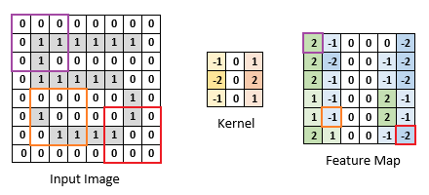
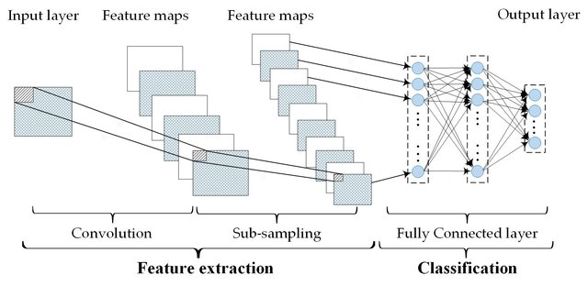

Convolutional Neural Networks
For effective feature extraction from images. Combined from following 2 kinds of layers
Convolutional Layers
Pooling Layers
The final output will be used for further learning.

Slide 34
Recurrent Neural Networks
Neural networks with feedback links.
From Elman network to LSTM or GRU.

Slide 35
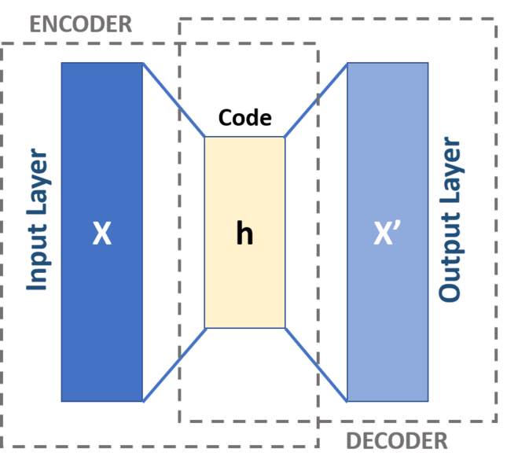
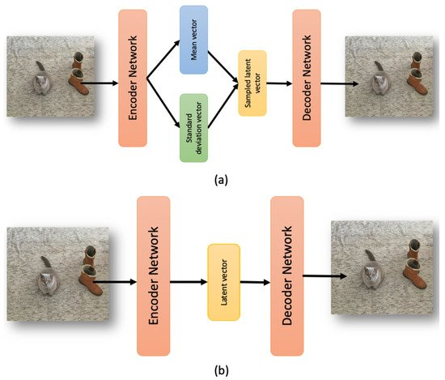
Auto-encoder/decoder
Concept: Compress input to extract short feature and then recovered as output.

Slide 36
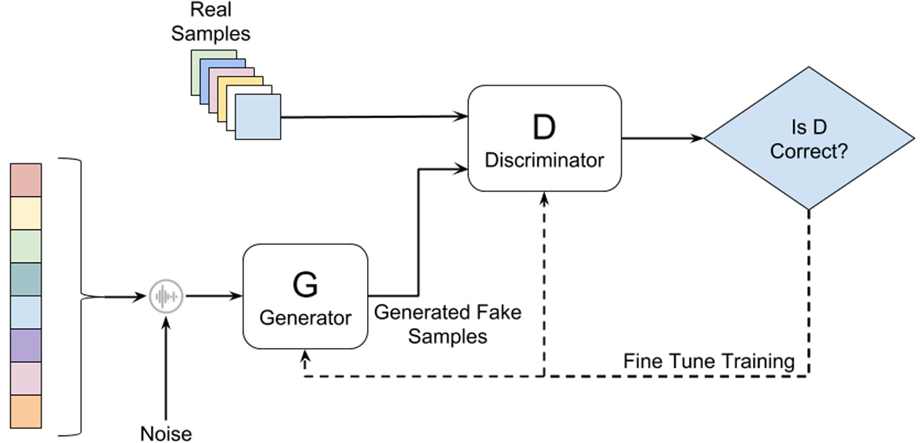
Generative Adversarial Networks
Basic Concept and Structure:

Slide 37
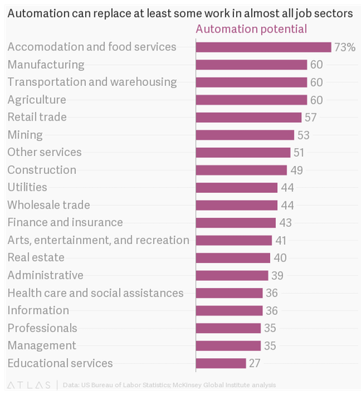
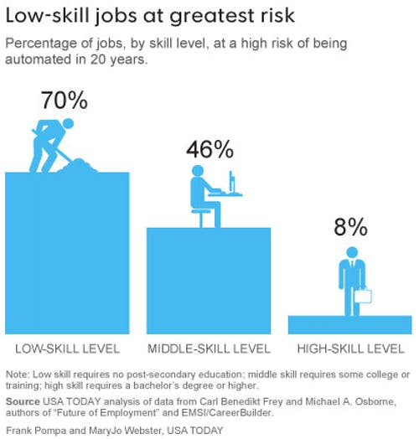
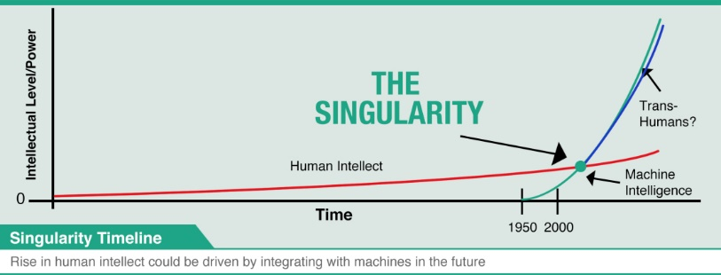
Future of AI: warnings
Replacement of routine repeated tasks.
Worries about “Singularity”.

Slide 38
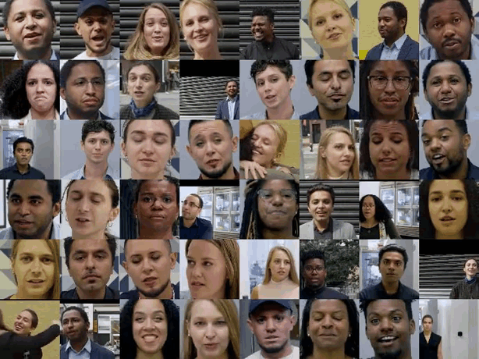
Future of AI: warnings
Deepfake: Can we believe what we see/hear?

Slide 39
Future of AI: promises
Augmented Intelligence: not for replacing but for helping human.
Seldonian algorithm: avoid unwanted bias in the dataset.
AutoML for automatically generated suitable model from dataset.

Slide 40
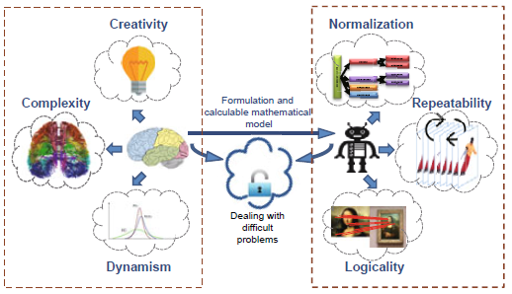
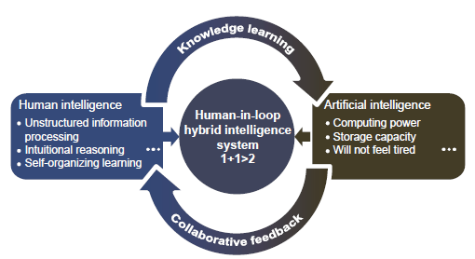
Augmented Intelligence
Artificial Intelligence Assist Human.

Slide 41
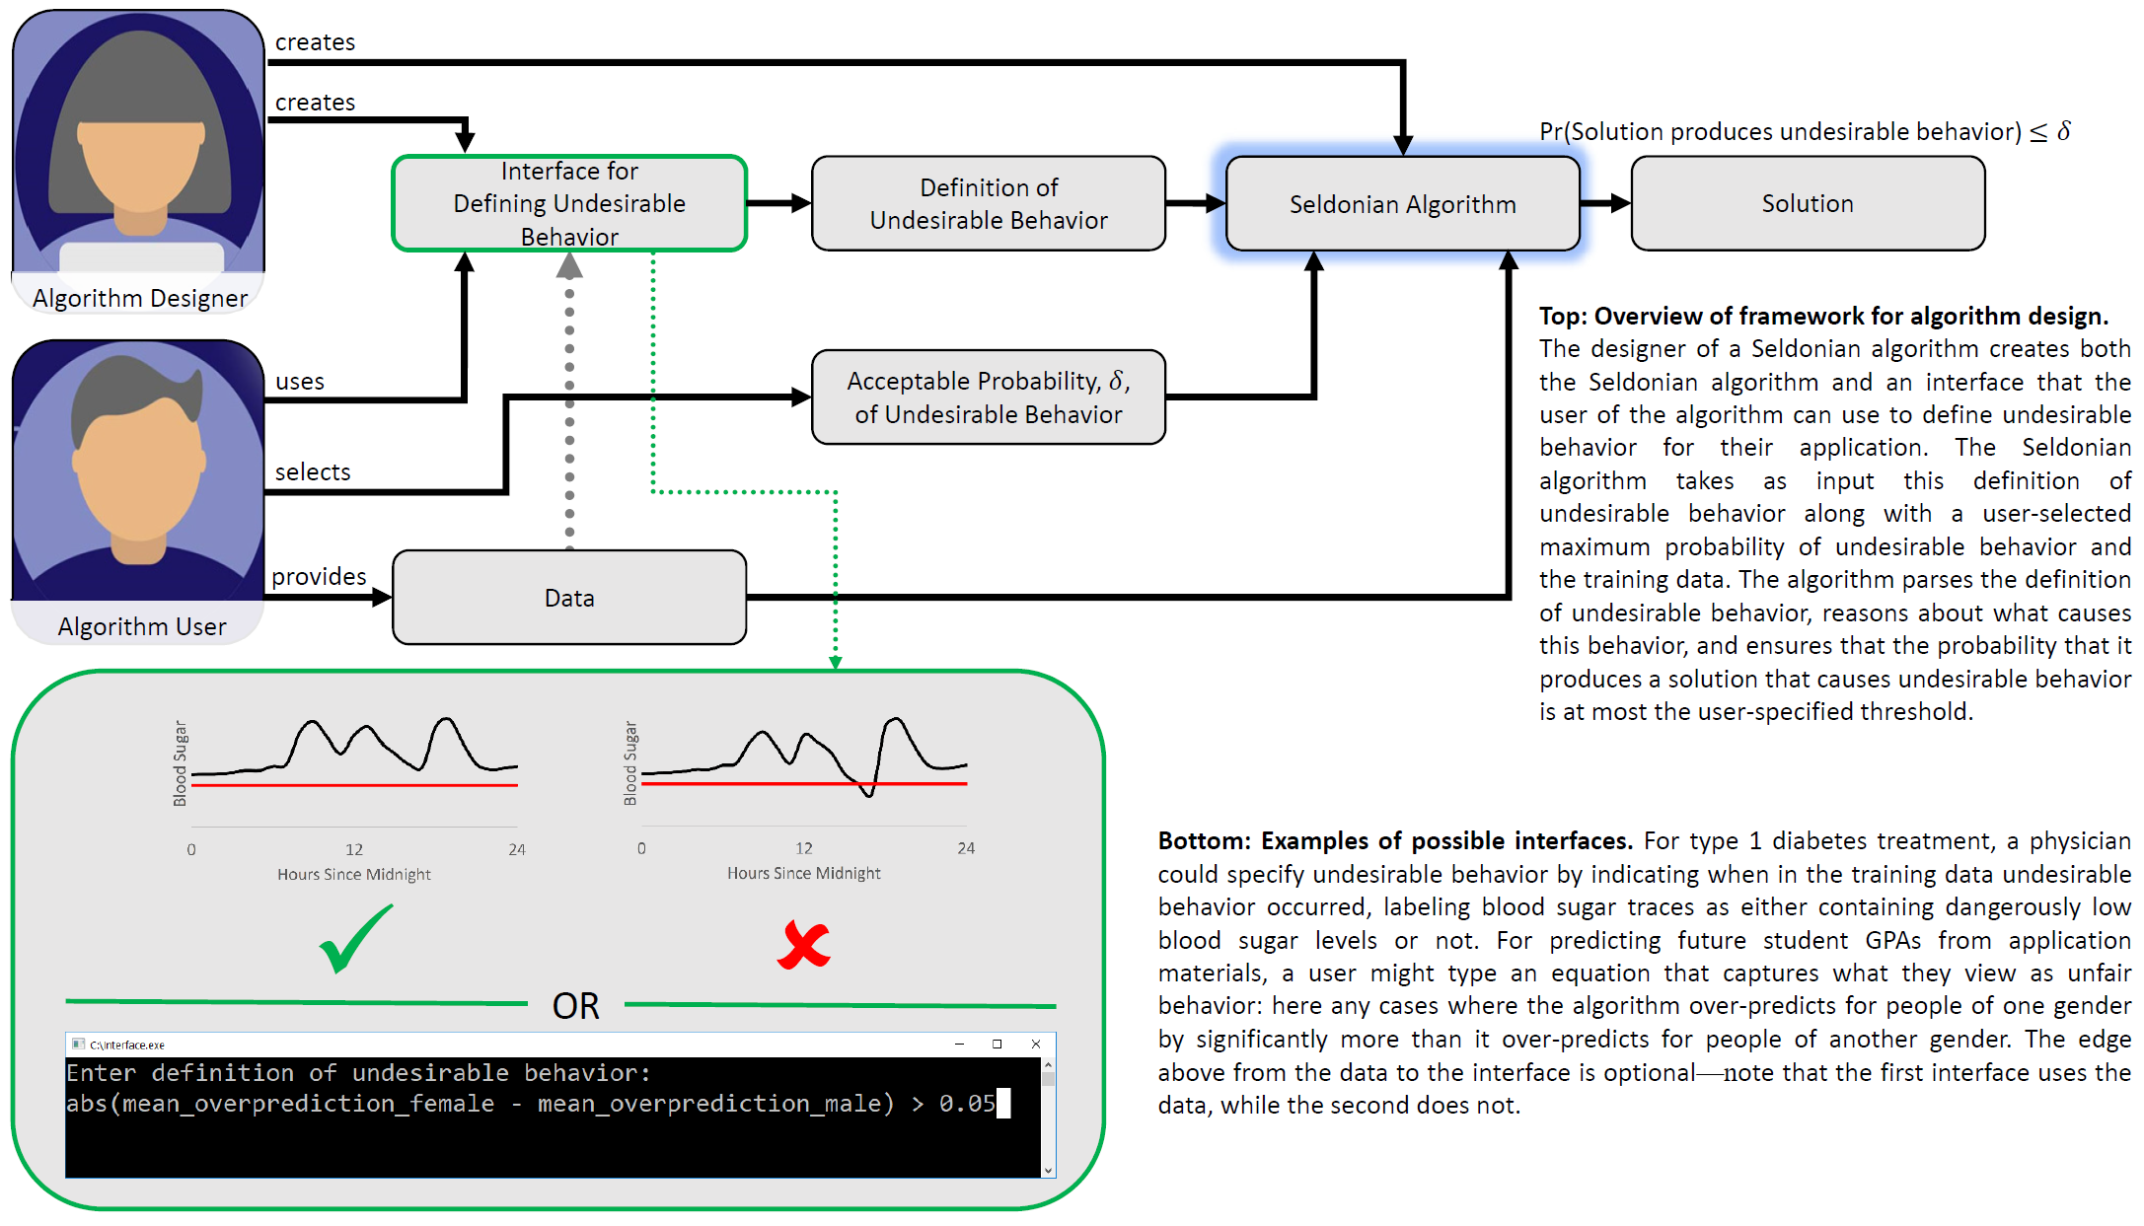
Seldonian algorithm

Slide 42
Auto ML
Automated Machine Learning Pipeline

Slide 43
Online AI materials
Artificial Intelligence Platforms:
Google Cloud: https://cloud.google.com/
Amazon AWS: https://aws.amazon.com/machine-learning/
Azure AI: https://azure.microsoft.com/overview/ai-platform/
Artificial Intelligence Experiments:
Google AI Experiments: https://experiments.withgoogle.com/collection/ai
OpenAI: https://openai.com/

Slide 44
Online AI materials
Artificial Researches:
Google AI Research: https://ai.google/research/
arXiv: https://arxiv.org/list/cs.AI/recent (for AI) https://arxiv.org/list/cs.LG/recent (for ML)
Youtube Channels: https://www.youtube.com/c/YannicKilcher (for recent research paper introduction) https://www.youtube.com/c/lexfridman (for interview of important people in AI)

